Slide 1
Digital Portfolio
STUDENT NAME: SHANMUGAPRIYA J
REGISTER NO AND NMID: 755DAB3F33F4BFAACEE4E14361036F9D
DEPARTMENT: B.Sc. INFORMATION TECHNOLOGY
COLLEGE: SRI KRISHNA ADITHYA COLLEGE OF ARTS AND SCIENCE / BHARATHIYAR UNIVERSITY

Slide 2
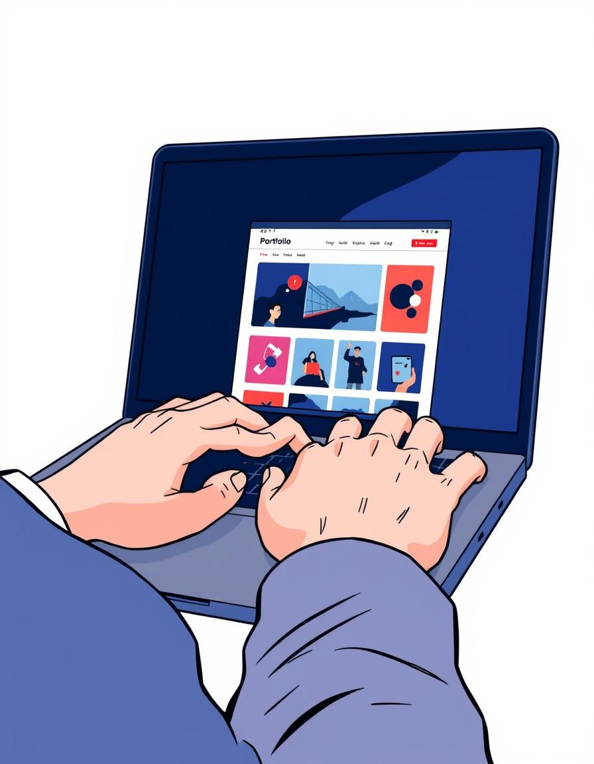
PROJECT TITLE
Innovations to Web Development: Digital Portfolio

Slide 3


AGENDA
Problem Statement
Project Overview
End Users
Tools and Technologies
Portfolio design and Layout
Features and Functionality
Results and Screenshots
Conclusion
Github Link
3/21/2024 Annual Review

Slide 4

PROBLEM STATEMENT
Many designers struggle to effectively showcase their skills and projects to potential employers. Traditional resumes lack the dynamic, interactive storytelling needed to display technical abilities and design thinking in web development.
This project aims to address the gap by creating a digital portfolio that not only presents work but also offers an engaging user experience that reflects professional competence.

Slide 5
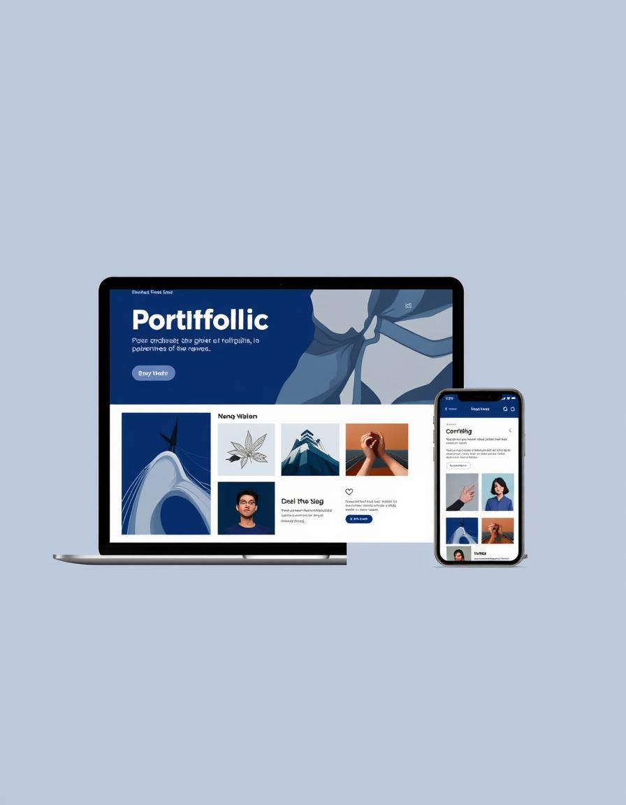
PROJECT OVERVIEW
The portfolio project integrates innovative web technologies with intuitive design principles to build a responsive, accessible platform. Features include project showcases, interactive demos, and a clean navigation system that highlight expertise across multiple domains.
The portfolio is optimized for desktop and mobile devices, providing seamless user experience regardless of screen size.

Slide 6
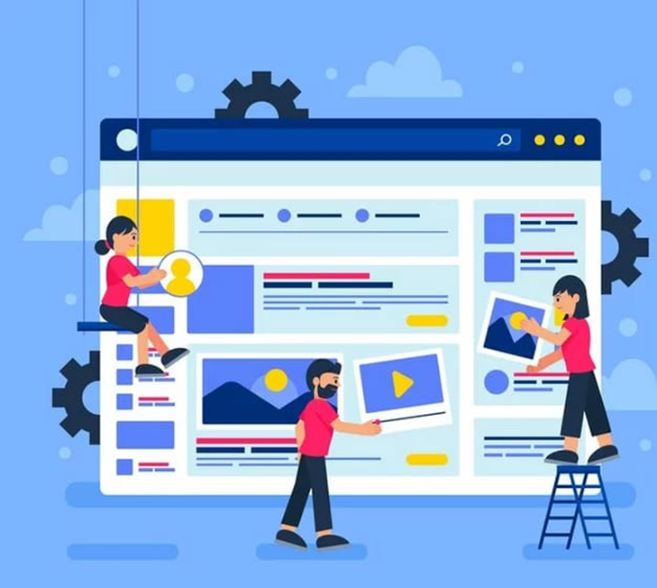

WHO ARE THE END USERS?
The primary users are prospective employers, recruiters, and clients looking to evaluate a designer or developer’s capabilities.
Secondary users include peers and collaborators interested in networking or sharing knowledge through showcased work.
Understanding user needs drives the portfolio’s usability, ensuring quick access to relevant information and an intuitive browsing experience.

Slide 7
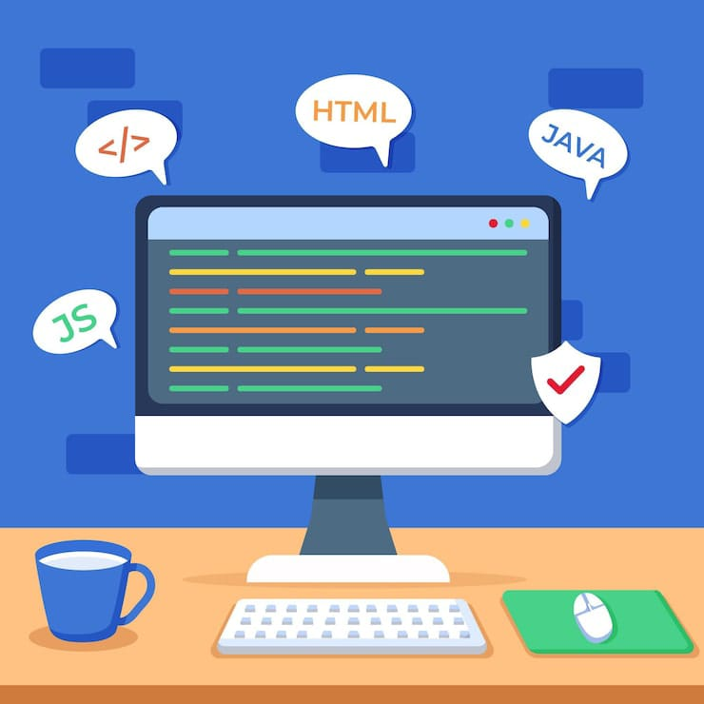
TOOLS AND TECHNIQUES
HTML
HTML5 & CSS3 for semantic and responsive layouts the foundation of the web, used to structure content like headings, paragraphs, and images.
CSS
Cascading Style Sheets is used to style that content, controlling colors, fonts, and spacing.
JavaScript
JavaScript and React to build interactive UI components a programming language that brings websites to life by adding interactive features
GitHub
GitHub is a platform used for version control, which is a system for tracking changes to code

Slide 8

POTFOLIO DESIGN AND LAYOUT
The design uses a minimalist aesthetic with bold typography and ample white space for clarity. A grid-based layout organizes projects into scannable sections.
Navigation is anchored by a sticky header with smooth scrolling between sections. Color palette is consistent with #609DFF accents for calls to action, improving visual hierarchy and user guidance.
8

Slide 9

FEATURES AND FUNCTIONALITY
Interactive project showcases with live demos and code snippets
Contact form with validation for direct communication
Filter and category tags for easy project browsing
Responsive design ensuring usability on all devices

Slide 10
RESULTS AND SCREENSHOTS
The portfolio received positive feedback for intuitive navigation and impactful visual storytelling. the project demos highly engaging and informative.
The provided code creates a fully responsive, multi-section student portfolio website. The final output is a single-page site with a clean, modern design.
A dark gray navigation bar with the logo "My Portfolio" is fixed at the top of the page. It includes links to different sections: Home, About, Projects, and Contact. On smaller screens, the links collapse into a hamburger menu icon (☰).
10

Slide 11
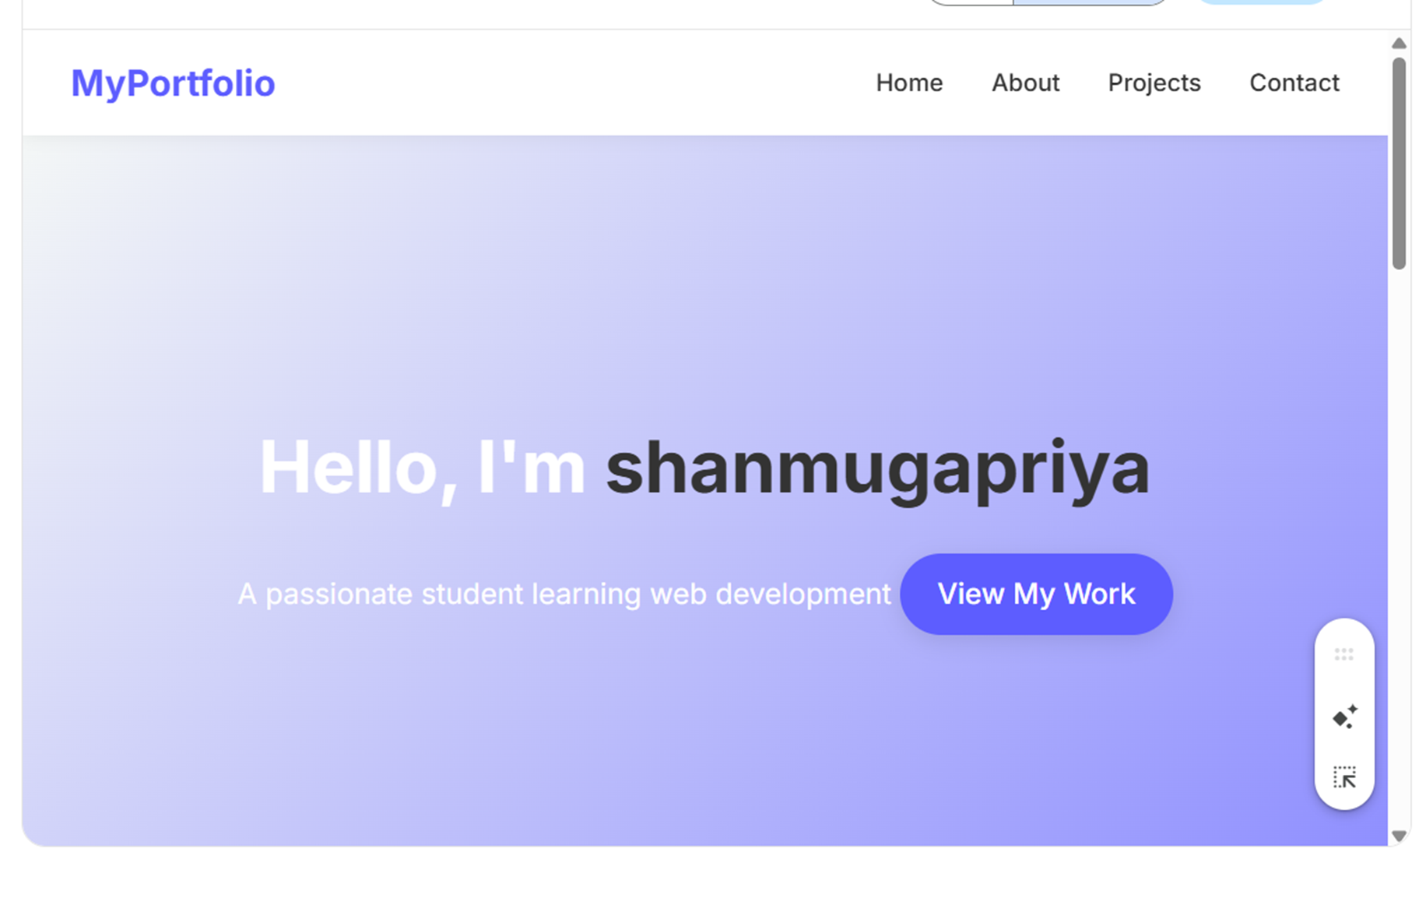
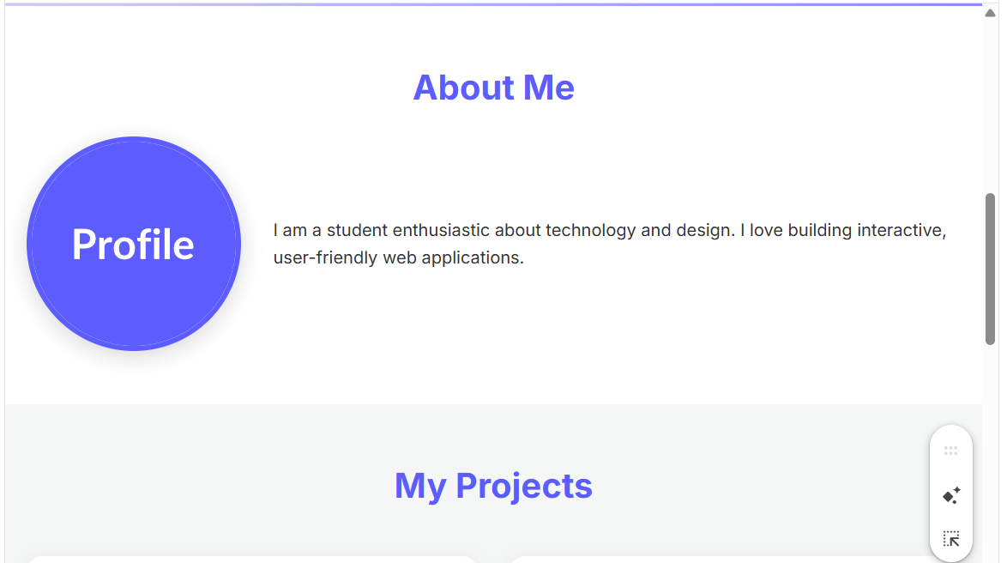
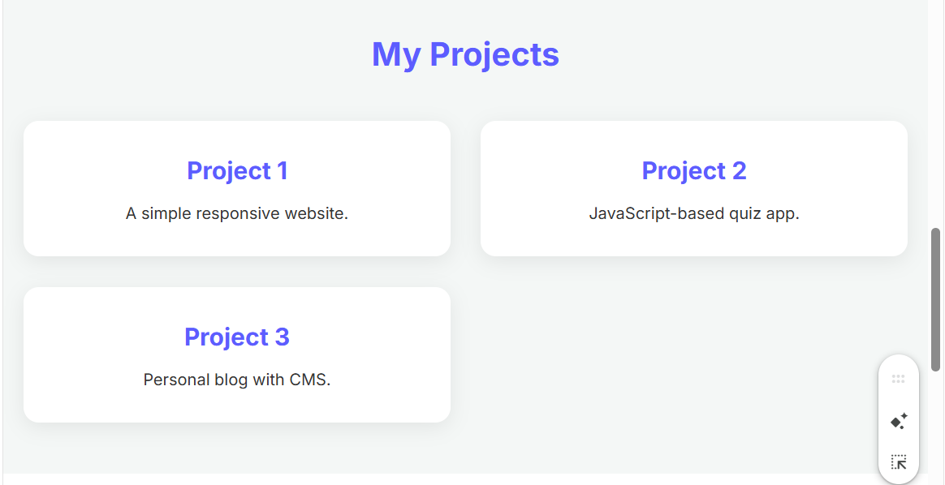
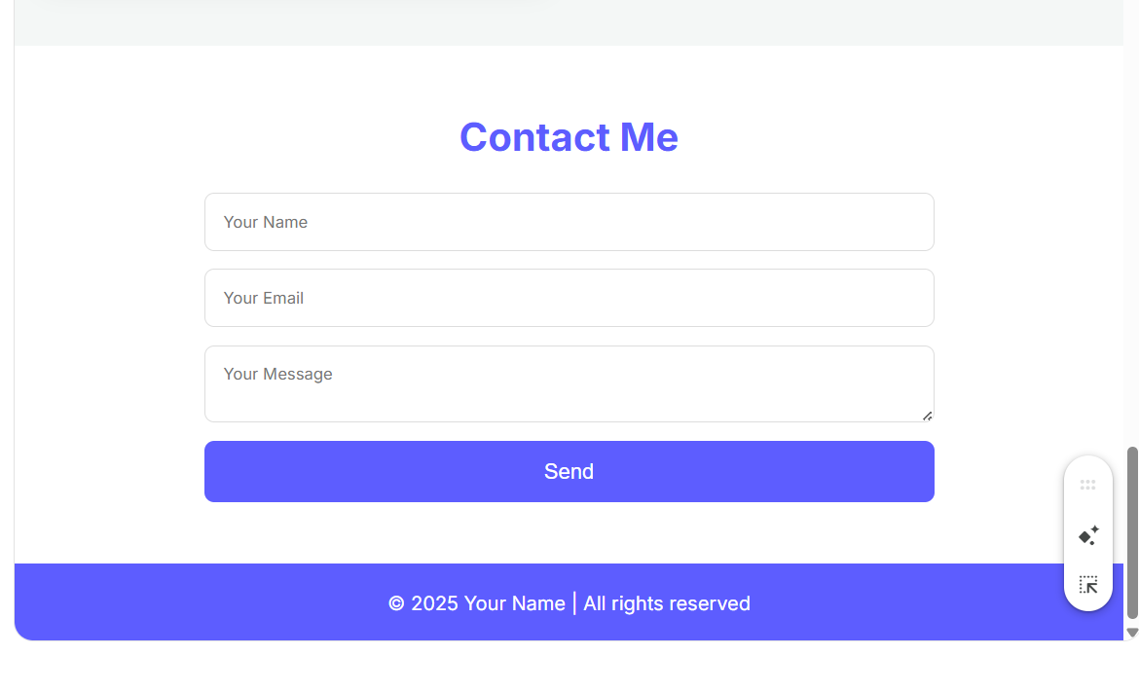

Slide 12
CONCLUSION
The digital portfolio, built with HTML for structure and CSS for styling, effectively presents an individual's skills and projects in a professional, organized, and visually appealing manner. By leveraging these fundamental web technologies, the portfolio achieves a clean design and full responsiveness, ensuring it looks great on any device, from desktops to mobile phones.
The project demonstrates a solid understanding of front-end development principles.
The portfolio is not just a static display but a dynamic tool for self-promotion, allowing the creator to showcase their work and make a strong impression on potential employers or collaborators. Ultimately, this digital portfolio serves as a powerful and accessible showcase of both technical skills and creative capabilities.
12

